Slide 1

Seminar on basic Linux Commands
Presented By
Charan Adhithya K
CSE

Slide 2


What is Linux?
Linux is a free, open-source operating system based on Unix.
Powers web servers, data centers, and mobile devices (Android).
Popular Distributions of Linux :
Ubuntu: User-friendly, great for beginners.
CentOS: Enterprise-focused, used for servers.
Debian: Known for its stability.
Fedora: Cutting-edge with the latest features.
Linux Kernel:
The core of the Linux operating system that handles
system resources.

Slide 3
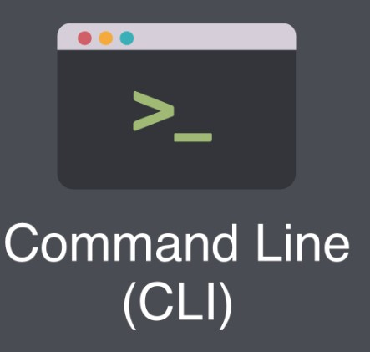
The Command Line Interface (CLI)
What is the CLI?
A text-based interface for interacting with the system.
Allows users to type commands to control the system.
CLI Benefits:
Faster and more powerful than graphical interfaces.
Supports automation through scripts.
CLI Prompt:
Typically displays information like the username, machine name,
and current directory (e.g., user@hostname:~$).
Structure of Commands:
Command: The program to be executed (e.g., ls, cd).
Options: Modify the command behavior (e.g., -l).
Arguments: Specify what the command will operate on (e.g., file.txt).

Slide 4
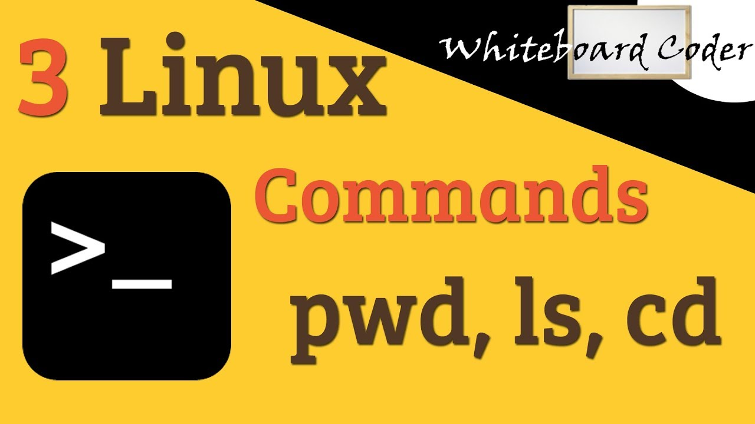
Basic Navigation Commands - pwd, ls, cd
pwd – Print Working Directory:
Shows the current directory’s full path.
Example: pwd → /home/user/Documents
ls – List Directory Contents:
ls -l: Lists files in long format, including permissions, ownership, and size.
ls -a: Includes hidden files (those starting with a dot).
ls -lh: Shows sizes in a human-readable format.
Example: ls -l → Lists files with detailed info.
cd – Change Directory:
Syntax: cd <directory-path>
Example: cd /home/user/Documents → Changes to the Documents directory.
Special Shortcuts:
cd ..: Move up one directory level.
cd ~: Navigate to the home directory.
cd -: Go back to the previous directory.

Slide 5
File Management - Creating Files (touch, nano, vi)
touch – Create an Empty File:
Syntax: touch <filename>
Example: touch file.txt → Creates an empty file named file.txt.
Use Case: Quickly create a new file without any content.
nano – Simple Text Editor:
A terminal-based text editor for editing files.
Example: nano file.txt → Open file.txt in the nano editor.
Shortcuts: CTRL + O to save, CTRL + X to exit.
vi – Advanced Text Editor:
Example: vi file.txt → Opens file.txt in vi.
Modes: Command mode (default), Insert mode (for typing), and Visual mode (for selection).
Press i to enter Insert mode, and :wq to save and quit.

Slide 6
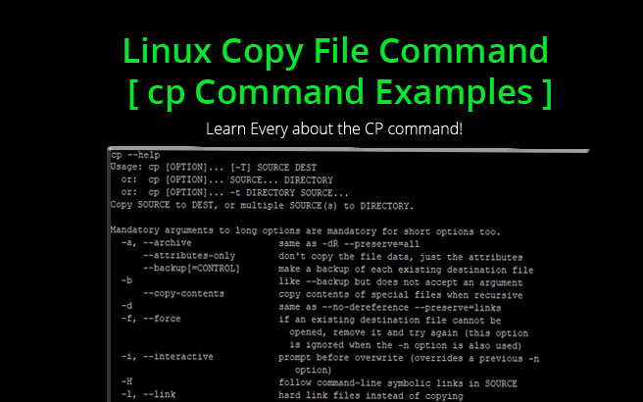
File Management - Copying Files (cp)
cp – Copy Files or Directories:
Syntax: cp <source> <destination>
Example: cp file1.txt file2.txt → Copies
file1.txt to file2.txt.
Copy Directories: Use -r to copy directories recursively.
Example: cp -r folder1/ folder2/ → Copies the
entire folder1 to folder2.
Other Options:
cp -i: Prompts before overwriting.
cp -u: Only copies when the source
file is newer than the destination.

Slide 7

File Management - Moving or Renaming Files (mv)
mv – Move or Rename Files:
Syntax: mv <source> <destination>
Example: mv file.txt /home/user/ → Moves file.txt to the home directory.
Renaming Files: mv file1.txt file2.txt → Renames file1.txt to file2.txt.
Move Directories: mv folder1/ folder2/ → Moves folder1 to folder2.
Options:
mv -i: Prompts before overwriting an existing file.
mv -u: Moves only when the source file is newer.

Slide 8
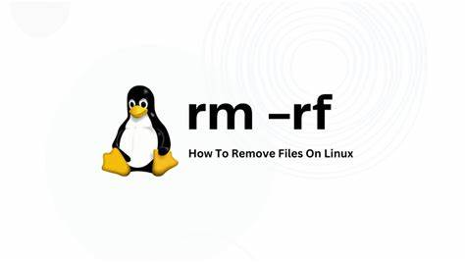
File Management - Removing Files (rm)
rm – Remove Files or Directories:
Syntax: rm <filename>
Example: rm file.txt → Deletes the file file.txt.
Removing Directories: Use -r to delete directories.
Example: rm -r folder1/ → Deletes folder1 and its contents.
Warning: rm is permanent, be careful!
Options:
rm -i: Asks for confirmation before deletion.
rm -f: Forces deletion without confirmation.

Slide 9
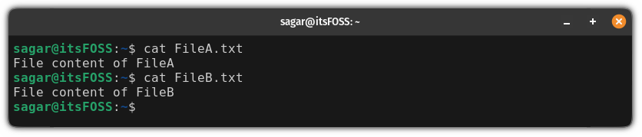
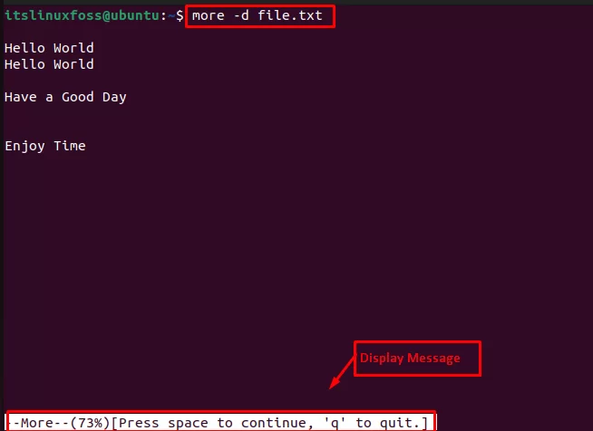
Viewing File Contents - cat, more, less
cat – Concatenate and Display File Contents:
Syntax: cat <filename>
Example: cat file.txt → Displays the contents of file.txt.
Use Case: Quick preview of small files.
more – View Files Page by Page:
Syntax: more <filename>
Example: more file.txt → Displays file.txt page by page.
Press SPACE to scroll, q to quit.
less – View Files with Advanced Scrolling:
Syntax: less <filename>
Example: less file.txt → Opens file.txt for easier reading with the ability to scroll both ways.

Slide 10

System Information - top, ps, htop
top – Display Running Processes:
Shows real-time information about active processes, CPU, memory, etc.
Example: top → Opens the process list with resource usage.
Usage: Press q to exit.
ps – View Processes:
Syntax: ps aux → Shows all running processes.
Options:
ps -e: Displays all processes.
ps -ef: Displays a detailed process list.
htop – Advanced Process Viewer:
More user-friendly and interactive than top.
Example: htop → Opens an interactive interface to manage processes.

Slide 11
System Information - df, free, uptime
df – Disk Space Usage:
Syntax: df -h → Displays disk usage in a human-readable format.
Example: df -h → Shows available and used disk space.
free – Memory Usage:
Syntax: free -h → Displays memory usage in a human-readable format.
Example: free -h → Shows total, used, and available memory.
uptime – System Uptime:
Displays how long the system has been running since the last reboot.
Example: uptime → Shows the system’s uptime along with load averages.

Slide 12
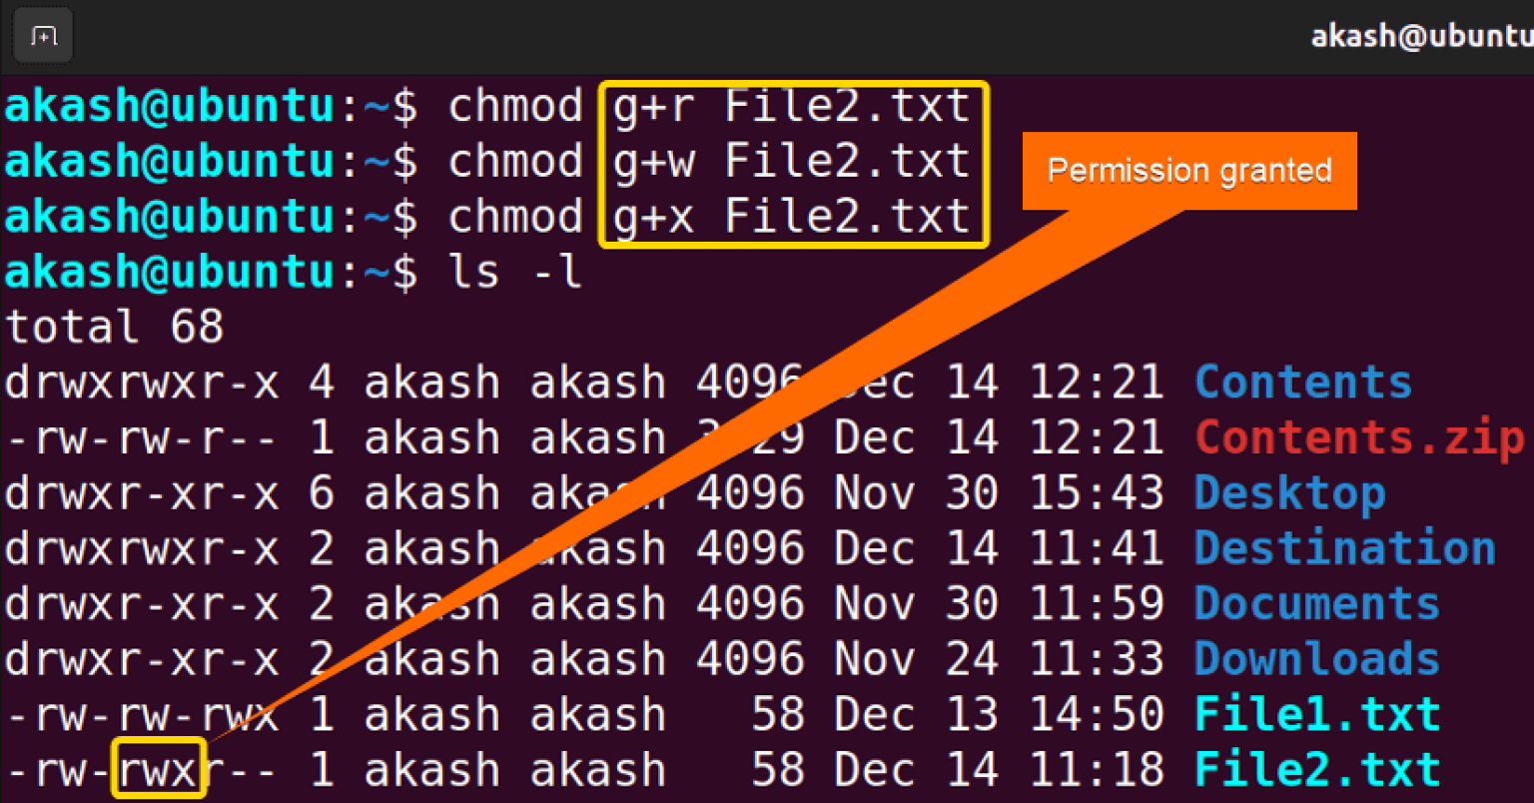
File Permissions - chmod, chown, chgrp
chmod – Change File Permissions:
Syntax: chmod <permissions> <filename>
Example: chmod 755 file.txt → Gives read, write, execute
permissions to the owner and read-execute to others.
Usage: Numeric (e.g., 755) or symbolic (e.g., u+x).
chown – Change File Owner:
Syntax: chown <user>:<group> <filename>
Example: chown user:group file.txt → Changes the file
owner and group.
chgrp – Change File Group:
Syntax: chgrp <group> <filename>
Example: chgrp group1 file.txt → Changes the group of
the file.

Slide 13
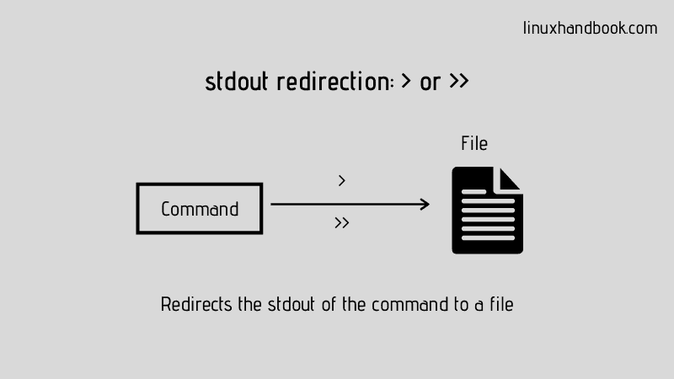

Redirection and Pipelines - >, >>, |
Redirection (>, >>):
> redirects command output to a file.
Example: echo "Hello, World!" > file.txt → Writes output to file.txt.
>> appends output to the end of a file.
Example: echo "Goodbye!" >> file.txt → Appends text to file.txt.
Pipelines (|):
Passes the output of one command as input to another.
Example: ls -l | grep "txt" → Lists all files and filters those with "txt".

Slide 14

Searching Files - find, grep, locate
find – Search for Files:
Syntax: find <directory> -name <filename>
Example: find /home/user/ -name "file.txt" → Searches for file.txt
in the specified directory.
grep – Search within Files:
Syntax: grep <pattern> <filename>
Example: grep "search_term" file.txt → Searches for "search_term" in file.txt.
Options: -i (ignore case), -r (recursive).
locate – Find Files by Name:
Syntax: locate <filename>
Example: locate file.txt → Quickly searches
the system for file.txt.

Slide 15
Summary of Key Commands:
Navigation: pwd, cd, ls
File Management: touch, cp, mv, rm
System Information: top, df, free, uptime
File Permissions: chmod, chown, chgrp
Redirection: >, >>, |
Search: find, grep, locate

